Slide 1

How do you tame a big ball of mud?
One test at a time.
Matt Eland
@IntegerMan
https://www.Linkedin.com/in/MattEland/
Slides and code available at: https://GitHub.com/IntegerMan/SoftwareQualityTalk/
Notes:
Matt Eland
Software Development Manager @ MoveHQ
Manage .NET and JavaScript / TypeScript Development, mostly focused on Web API and Reports, but I do a bit of SPA
I’m on LinkedIn and Twitter
The slides and code will be available via a Git Repository and Linked In slide share. I’ll put them in the Meetup later on.

Slide 2
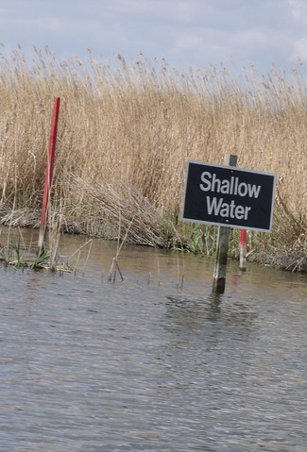

About this Talk
Aim is to widen your exposure and spark new ideas
Focused on a wide variety of libraries
Will not get deep into any technology
Examples in C#, .NET Core, and XUnit
Unit Testing 101
Improving Unit Tests
Other Tools & Processes
Conclusion

Slide 3
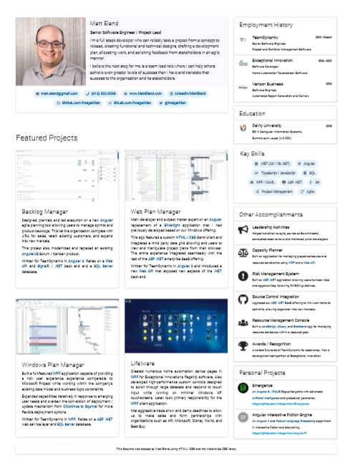
Sample Codebase: Resume Scoring Algorithm
System
Under Test
Resume Score
Notes:
Yes, this is really my resume from last year. I was looking for an Angular team lead role and instead now manage a .NET services team. Life is funny.

Slide 4
It’s a Legacy System!
Congratulations!
With Over 50k lines of code and 0 tests
And we need you to add this new feature…

Slide 5

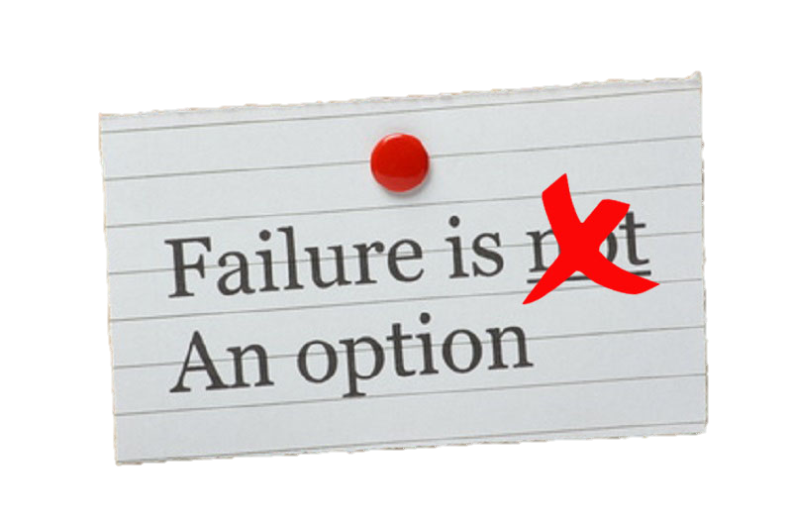


What Do You Do?

Slide 6

Build your own Safety Net

Slide 7
Unit Testing 101
Because unit tests should not be an endangered species.
Notes:
Show of hands: who writes unit tests on a somewhat regular basis?

Slide 8
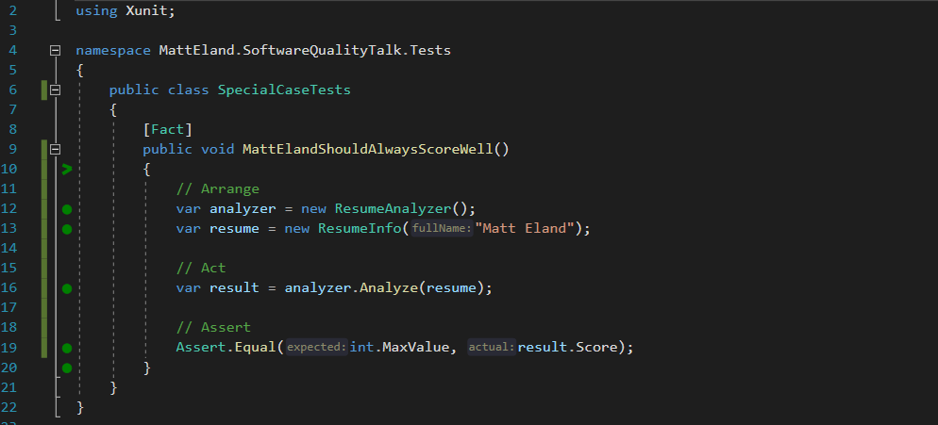
What is a Unit Test?
Notes:
This is Xunit, other frameworks are Nunit and MSTest. All of which have similar syntax

Slide 9
Test Driven Development (TDD)
Green
Clean up System Under Test
Red
Write a failing test
Make the test pass
Refactor

Slide 10

I can’t test my code because _______________ !

Slide 11
I can’t test my code because _______________ !
it works with the UI
Some options:
Then don’t test the user interface
Make the view layer as small and dumb as possible, then test the rest
Supplement with Automated UI Testing as needed

Slide 12
I can’t test my code because _______________ !
Database Dependencies
Some options:
Remove the database dependency via Dependency Injection
Use Entity Framework and in-memory database tests
Keep talking to the database, but work around the limitation

Slide 13
I can’t test my code because _______________ !
it’s a big ball of mud
Some options:
Git Gud
Don’t test, but expect bugs
Place some “pinning tests”, then refactor to a better architecture

Slide 14
Taming a big ball of mud
Build a Safety Net
Improve Testability
Improve your Tests
Refactor the Code
Expand Your Tests

Slide 15
Build a Safety Net
If you don’t pin down current behavior, you won’t know when you change it

Slide 16
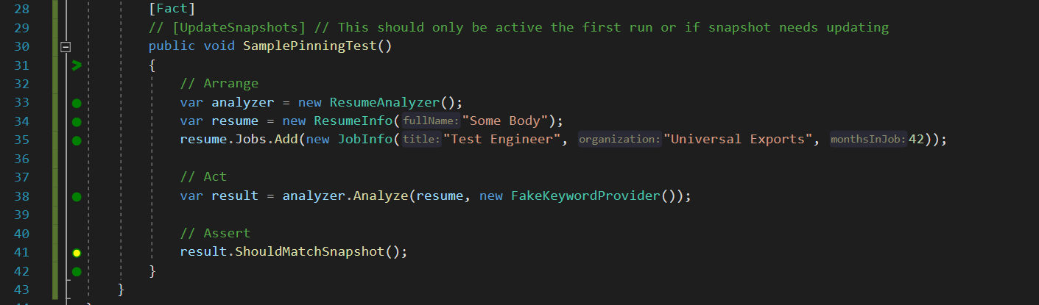
Testing Object State with Snapper
GitHub Repo: https://theramis.github.io/Snapper/

Slide 17
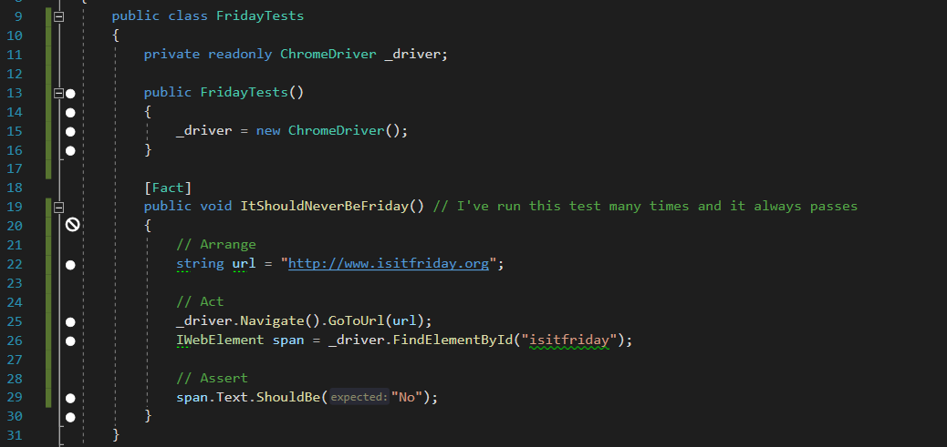
Selenium WebDriver Tests
GitHub Repo: https://github.com/SeleniumHQ/selenium

Slide 18
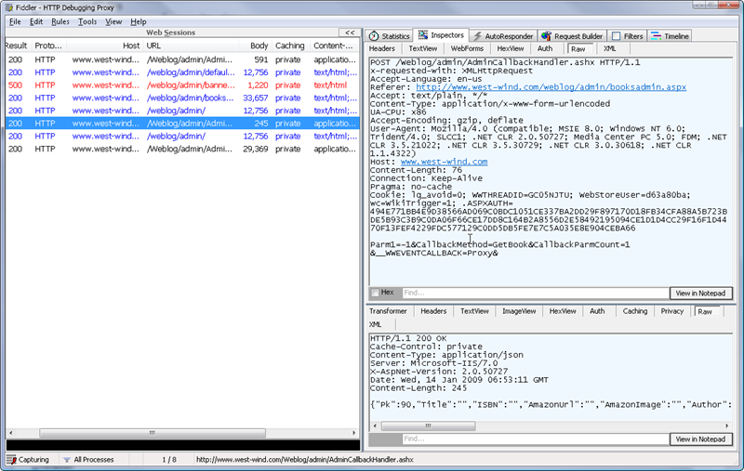
Inspecting Web Traffic with Fiddler
Product Page: https://www.telerik.com/fiddler

Slide 19
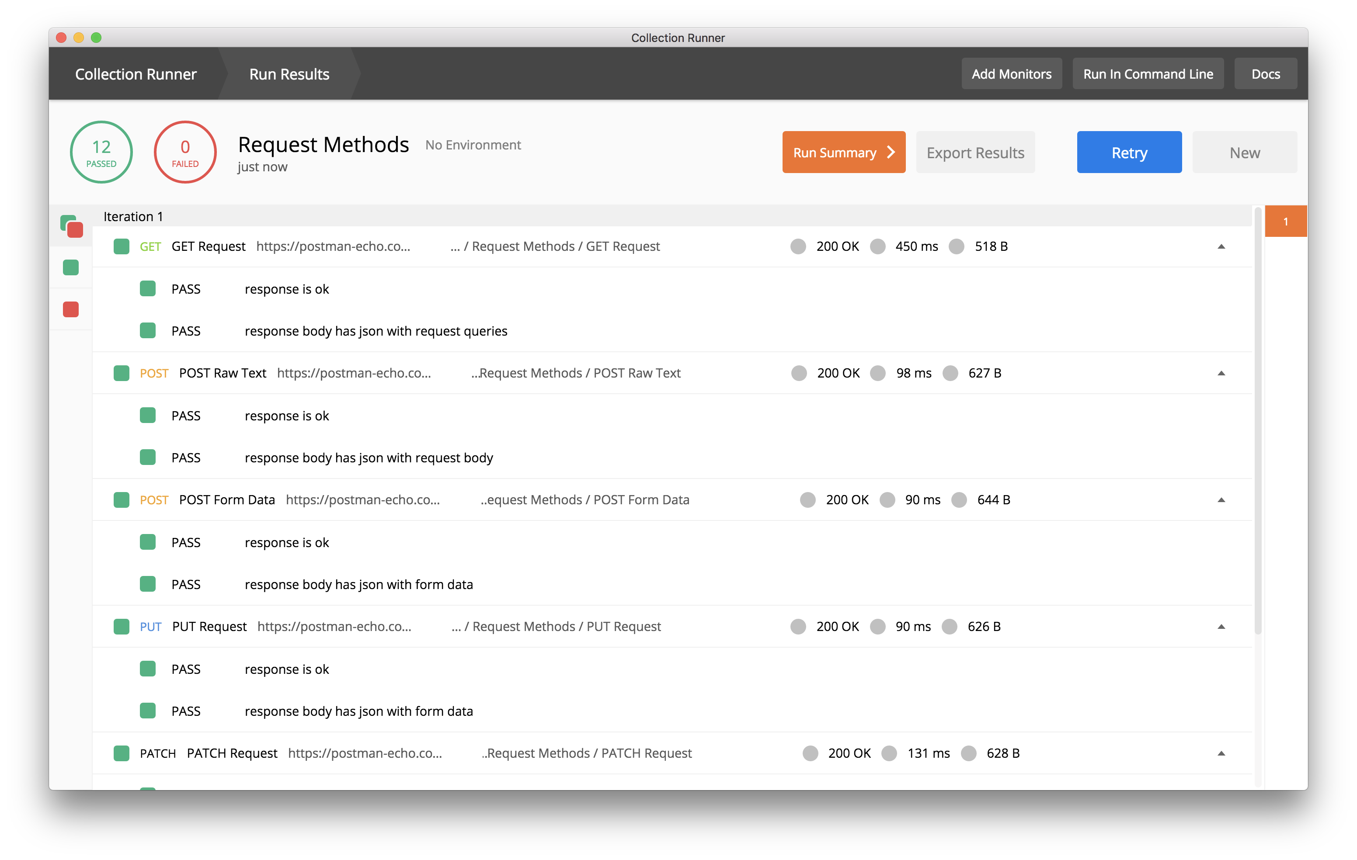
Postman Collections For API Testing
API Testing Blog Post: https://blog.getpostman.com/2017/10/25/writing-tests-in-postman/

Slide 20
Improve Testability
If everything is tied together, all we’re doing is integration tests

Slide 21
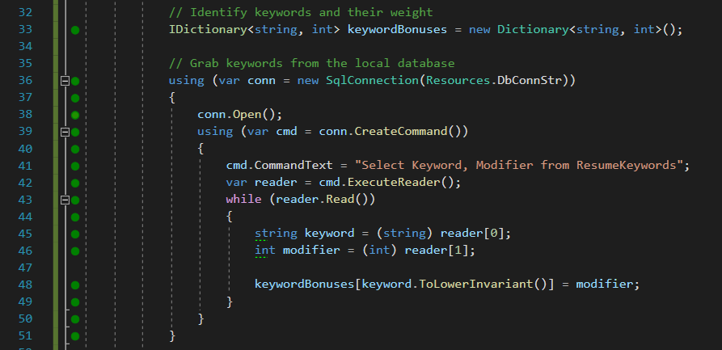
Removing Database Dependencies Example

Slide 22
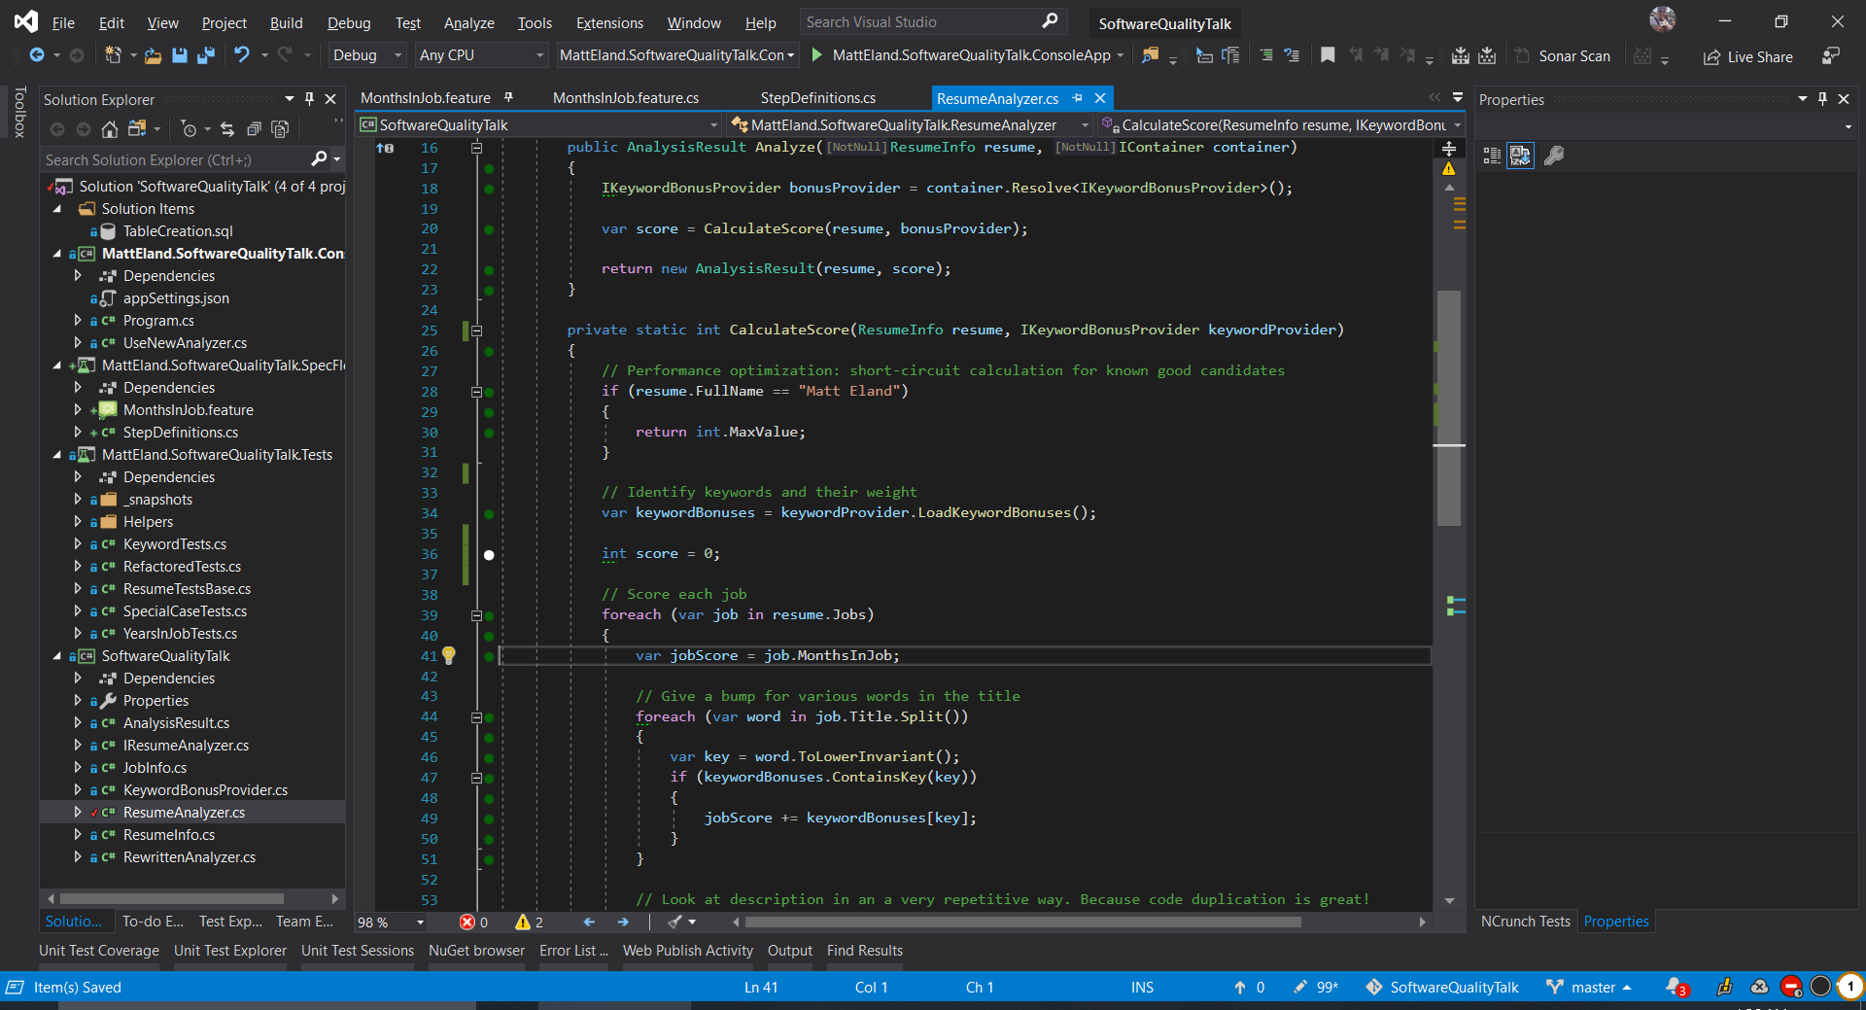
Removing Database Dependencies Example

Slide 23
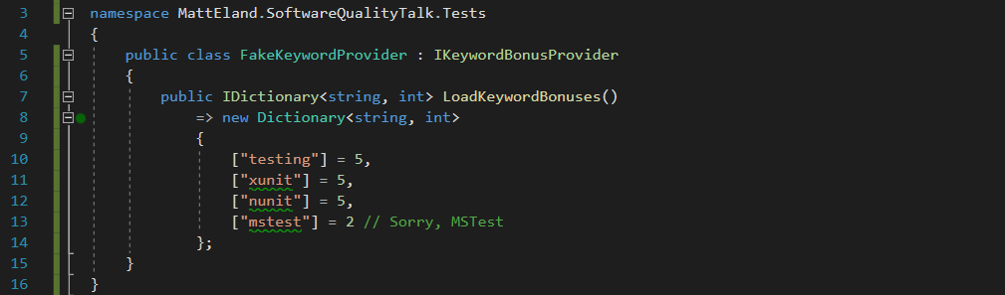
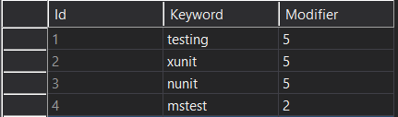
Removing Database Dependencies Example

Slide 24
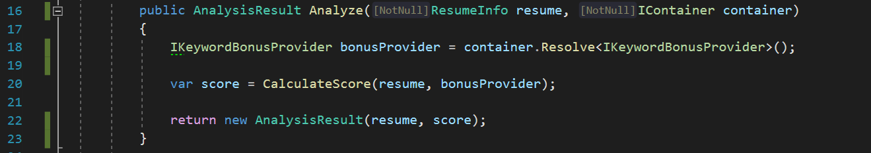
Inversion of Control with AutoFac
GitHub Repo: https://github.com/autofac/Autofac

Slide 25
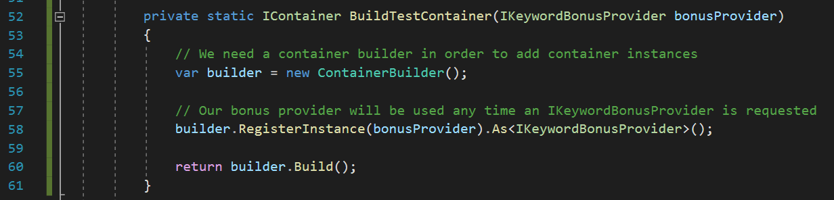
Inversion of Control with AutoFac
GitHub Repo: https://github.com/autofac/Autofac

Slide 26
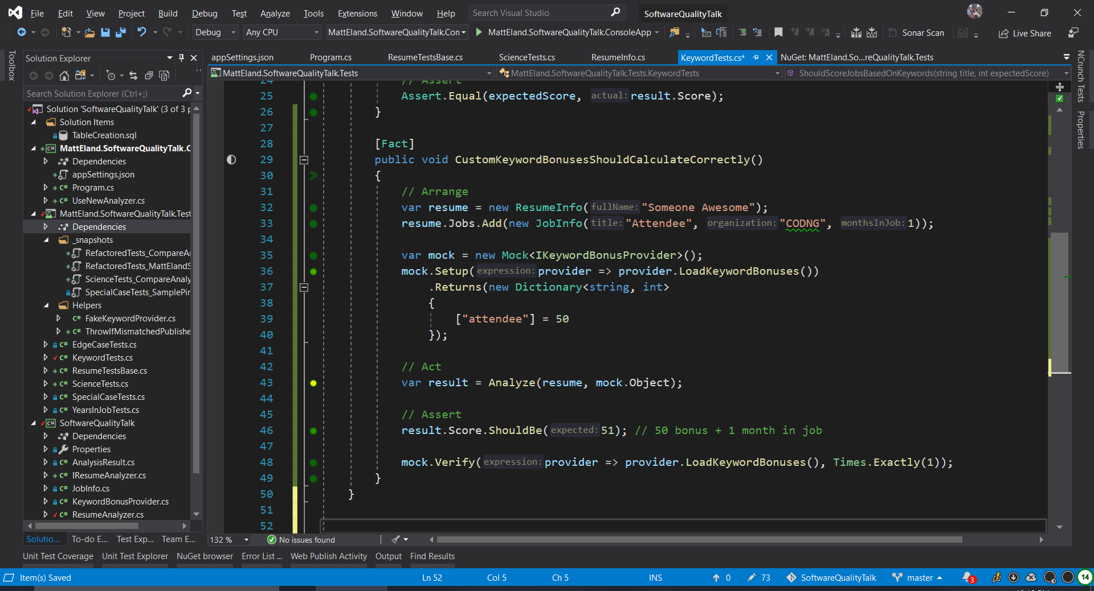
Moq to Simplify Fake Object Creation
GitHub Repo: https://github.com/Moq/moq4

Slide 27
Moq to Simplify Fake Object Creation
GitHub Repo: https://github.com/Moq/moq4

Slide 28
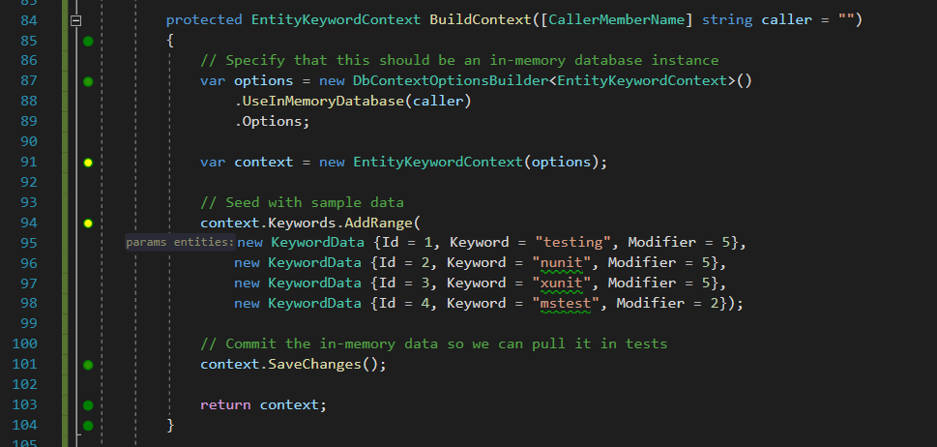
In Memory Tests with Entity Framework Core

Slide 29
Improve Your Tests
Before we scale our tests up, we need to make sure we’re happy with them

Slide 30
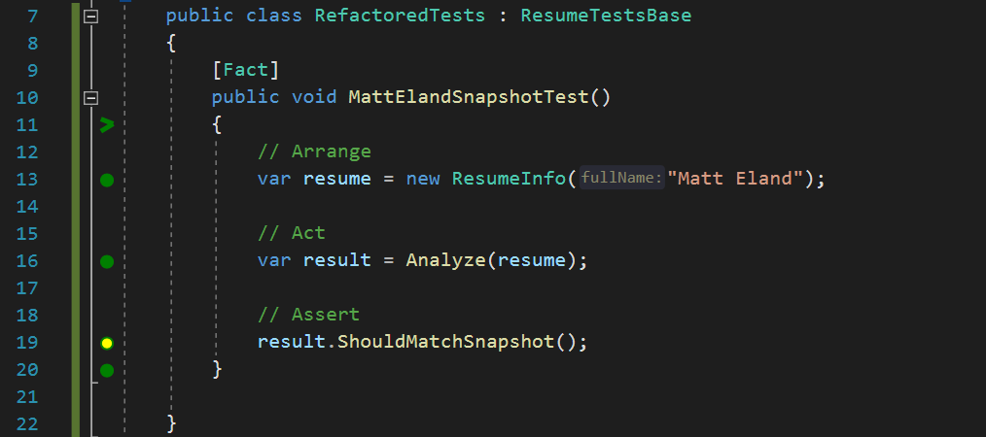
Refactor your Test Code

Slide 31
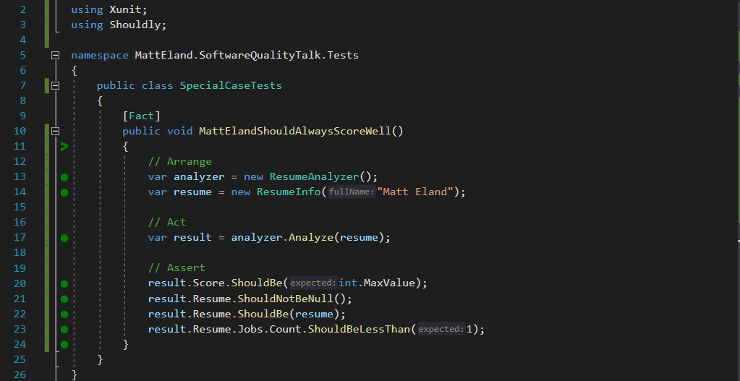
Shouldly
Nice and readable, plus I’ll never confuse actual and expected ordering again.
GitHub Repo: https://github.com/shouldly/shouldly

Slide 32
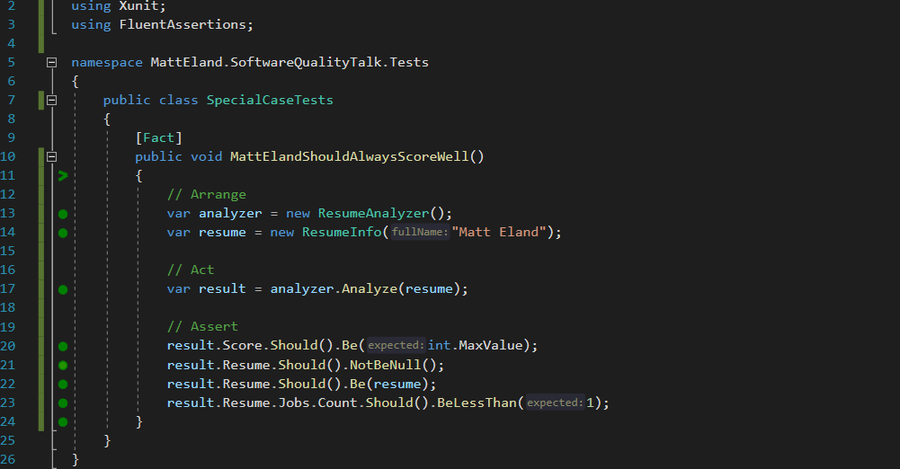
FluentAssertions
The same as Shouldly, except now with more parentheses
GitHub Repo: https://github.com/fluentassertions/fluentassertions

Slide 33
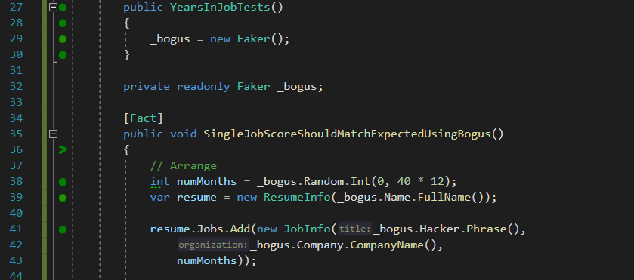
Generating Test Data with Bogus
GitHub Repo: https://github.com/bchavez/Bogus

Slide 34
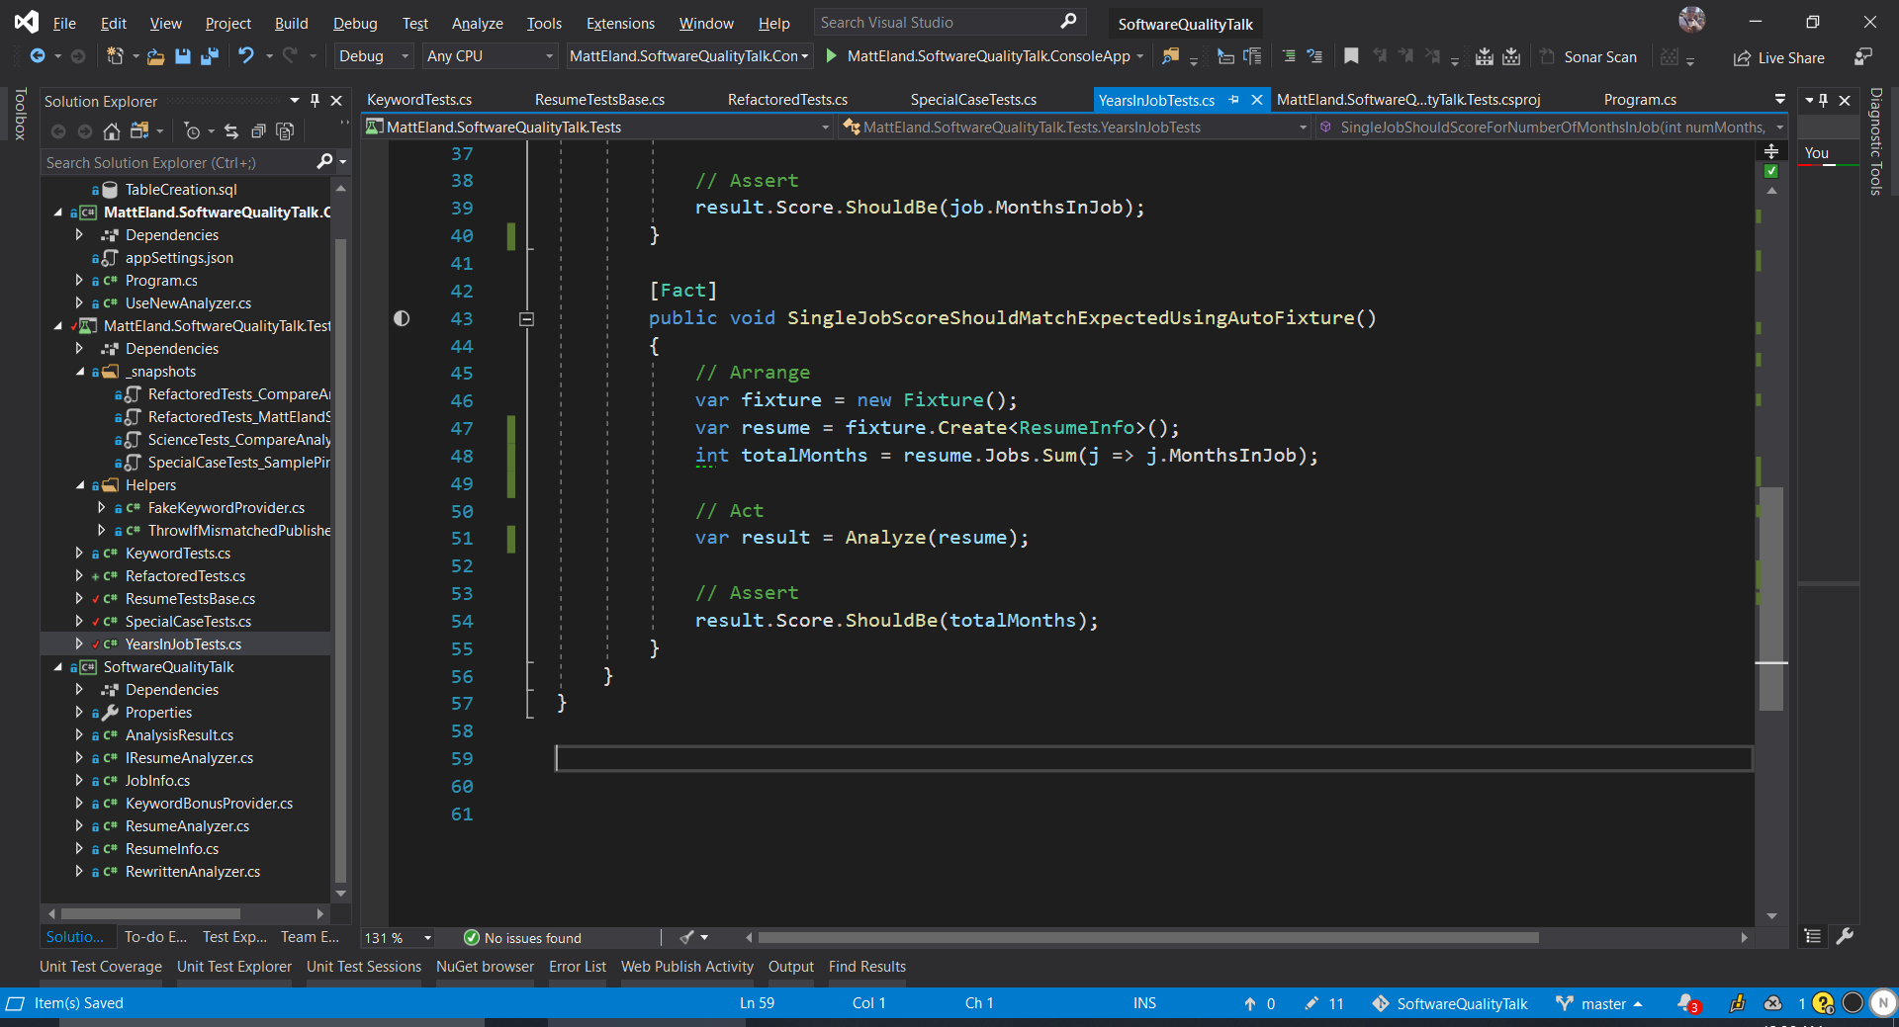
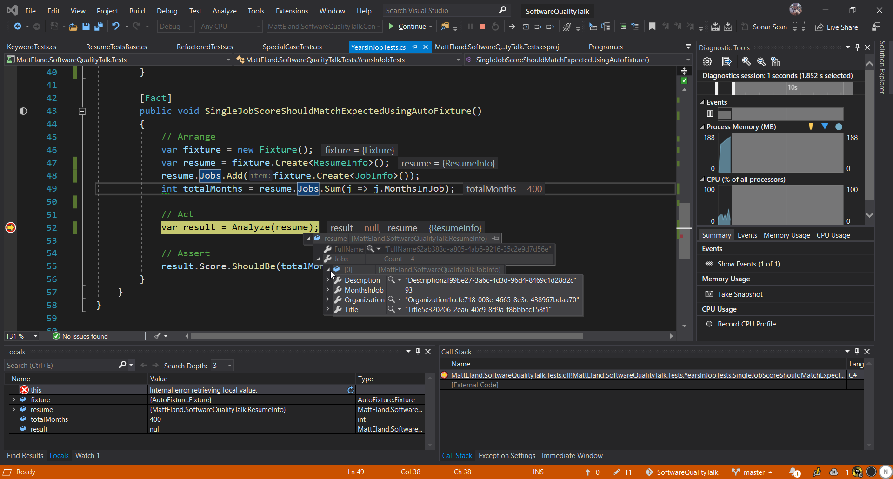
AutoFixture
GitHub Repo: https://github.com/AutoFixture/AutoFixture

Slide 35
Refactor the Code
Improve your code without treating your users as canaries

Slide 36
Typical Deployments
Client
Legacy Routine
New Routine

Slide 37
Typical Rollbacks
Client
Legacy Routine
New (Buggy) Routine

Slide 38
Feature Flags
Use New Routine?
Client
Legacy Routine
New Routine
New Routine

Slide 39
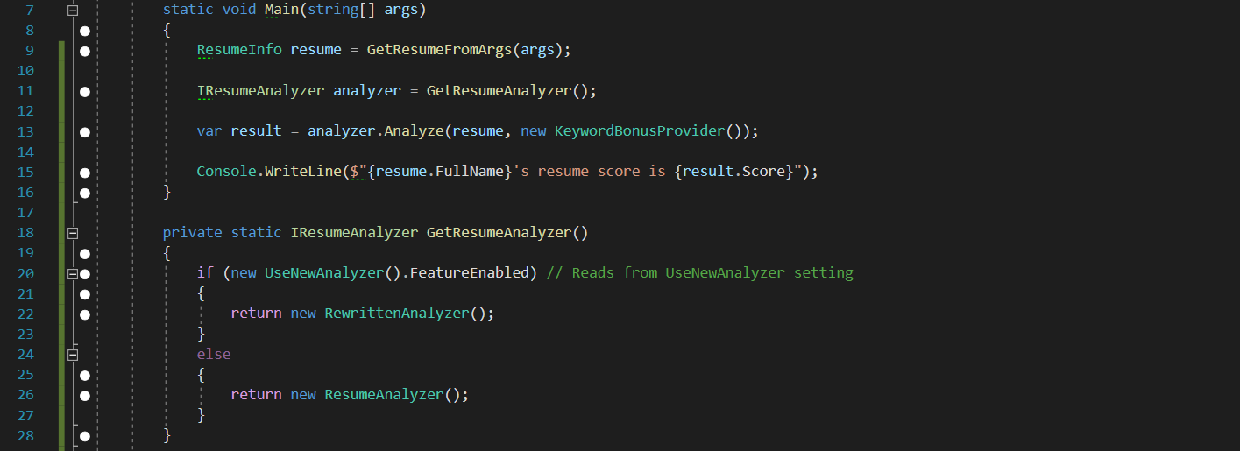
Adding a Fallback Option with FeatureToggle
GitHub Repo: https://GitHub.com/jason-roberts/FeatureToggle

Slide 40
Canary Testing
Is Beta User?
Client
Legacy Routine
New Routine

Slide 41
Victimless Canary Testing with Scientist .NET
Client
Scientist .NET
Legacy Routine
New Routine
GitHub Repo: https://GitHub.com/ScientistProject/Scientist.net

Slide 42
Victimless Canary Testing with Scientist .NET
Client
Scientist .NET
Legacy Routine
Results Publisher
New Routine
GitHub Repo: https://GitHub.com/ScientistProject/Scientist.net

Slide 43
Unit Testing with Scientist .NET
Unit Test
Scientist .NET
Legacy Routine
Results Publisher
New Routine
GitHub Repo: https://GitHub.com/ScientistProject/Scientist.net

Slide 44
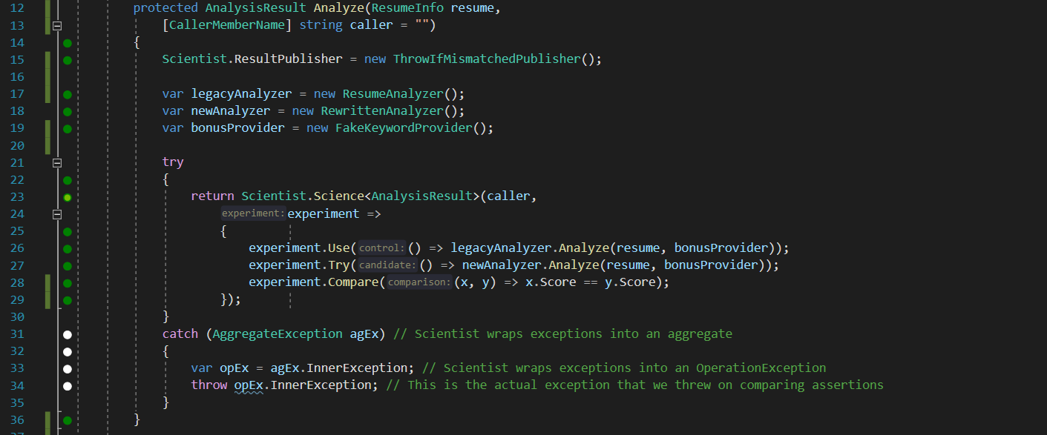
Experiments with Scientist .NET
GitHub Repo: https://GitHub.com/ScientistProject/Scientist.net

Slide 45
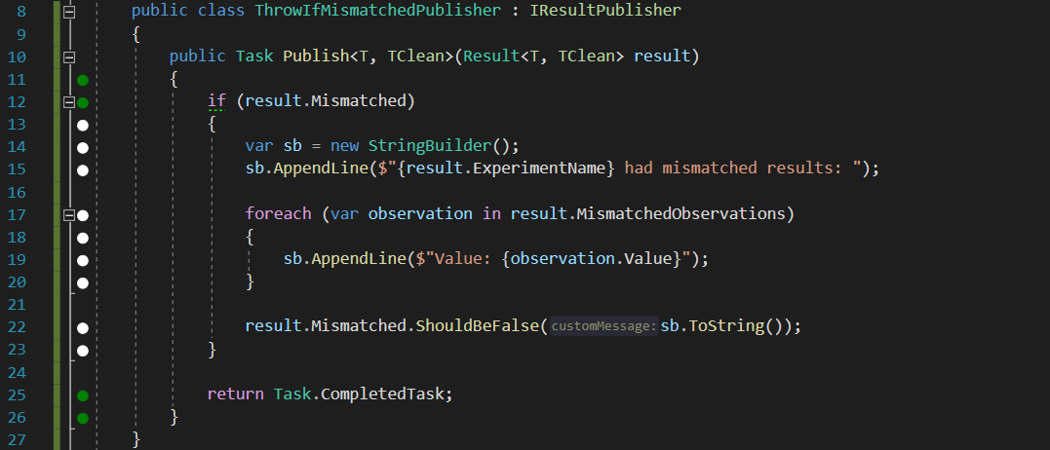
Publishing Results with Scientist .NET
GitHub Repo: https://GitHub.com/ScientistProject/Scientist.net

Slide 46
Expand the Tests
“The unit tests must flow”
- Nobody (that I know of)

Slide 47
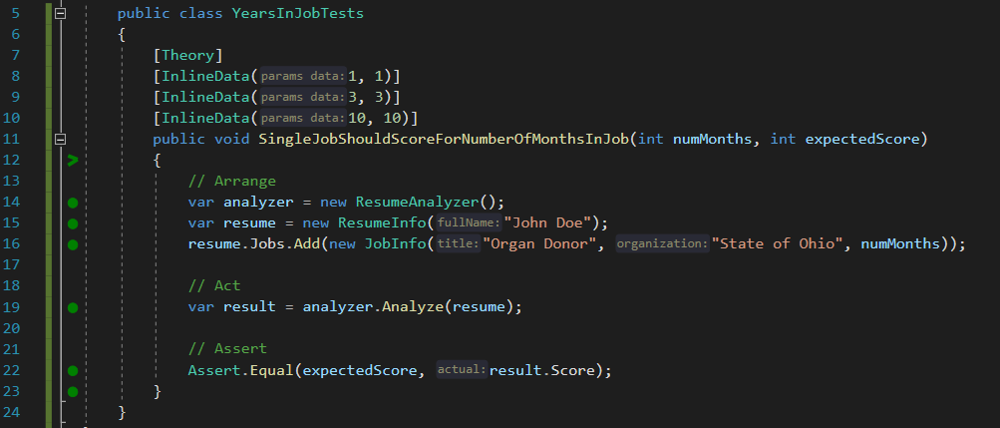
Parameterized Unit Tests

Slide 48
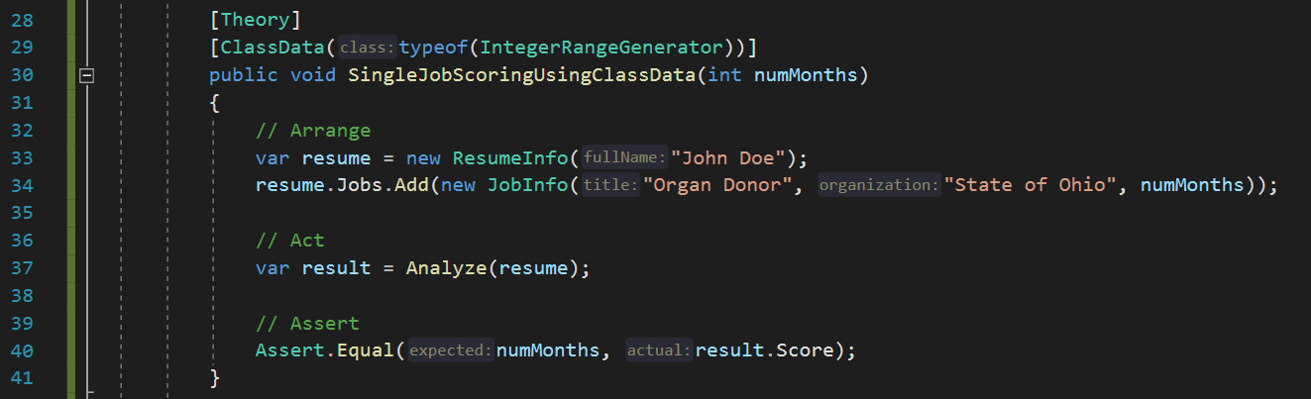
Class Data Tests for Custom Data

Slide 49
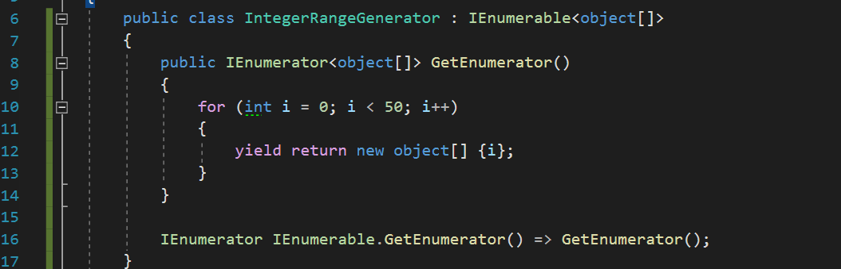
Class Data Tests for Custom Data

Slide 50
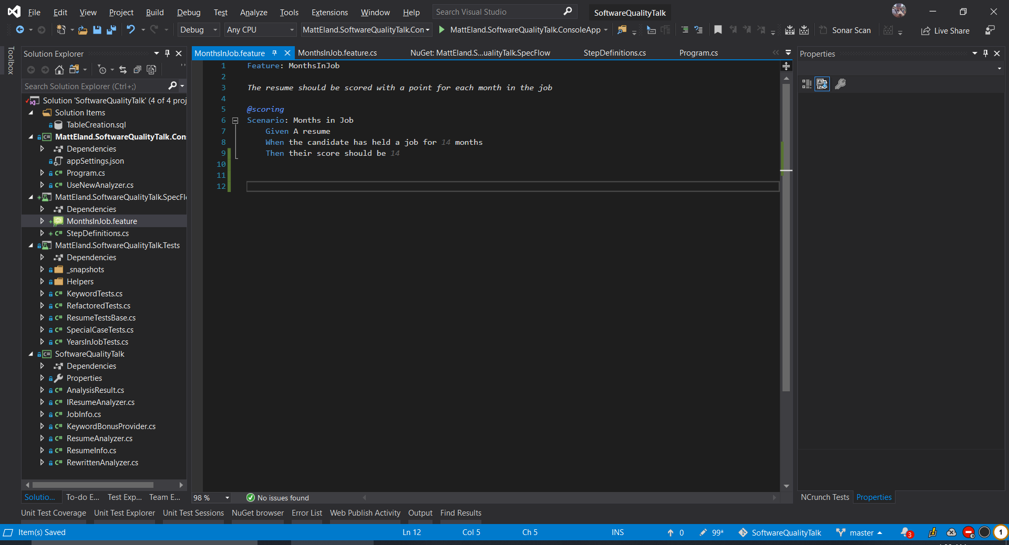
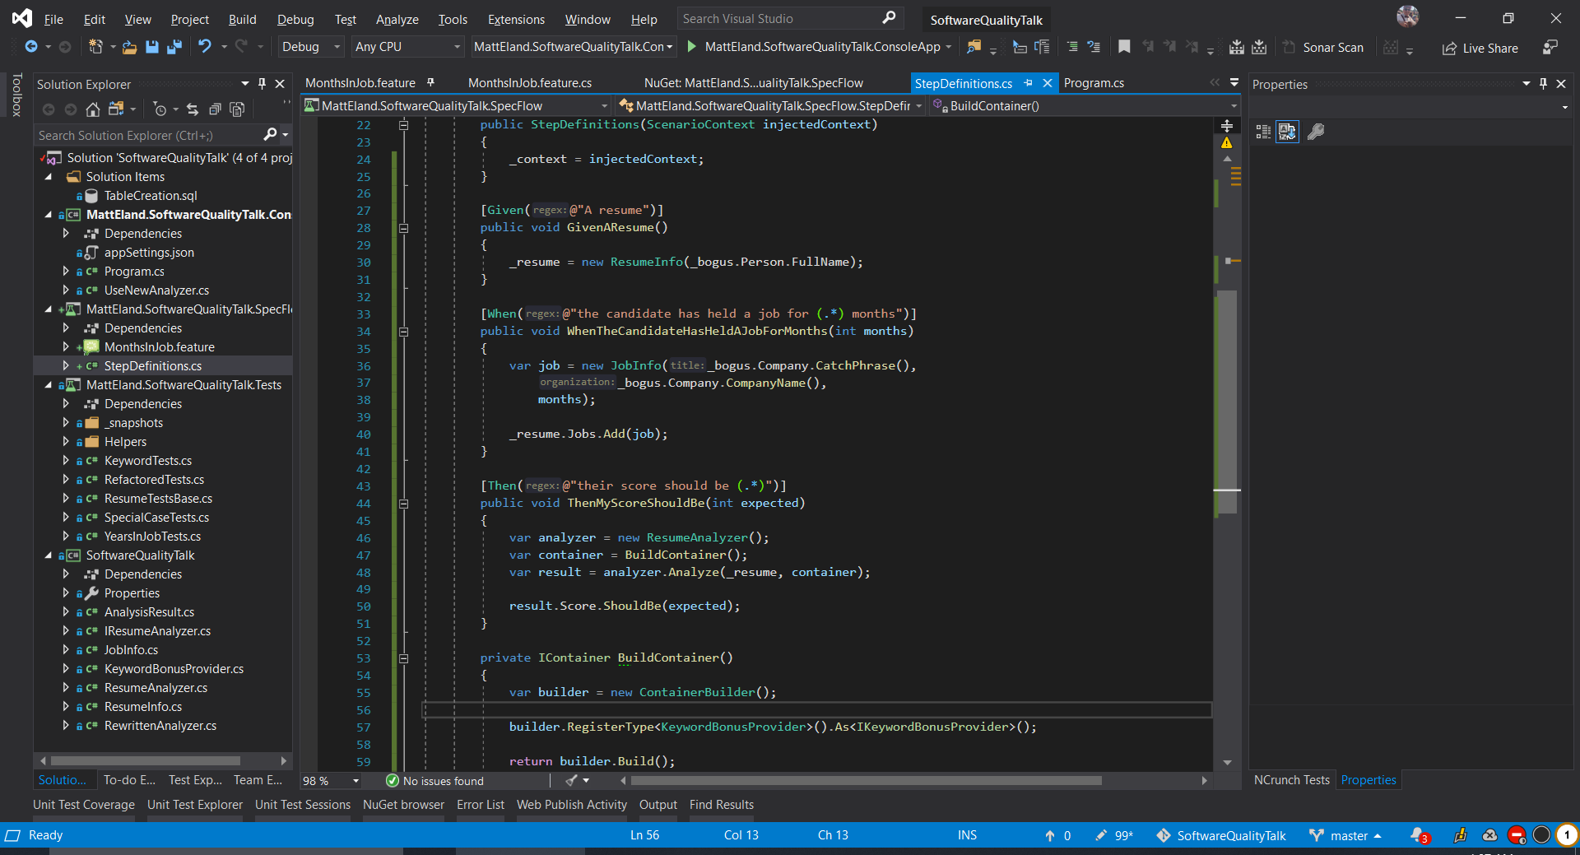
Behavior Driven Development with SpecFlow
Home Page: https://specflow.org/

Slide 51
SpecFlow Steps Definitions
Home Page: https://specflow.org/

Slide 52
Tools & Processes
Because there’s more to quality than just code

Slide 53
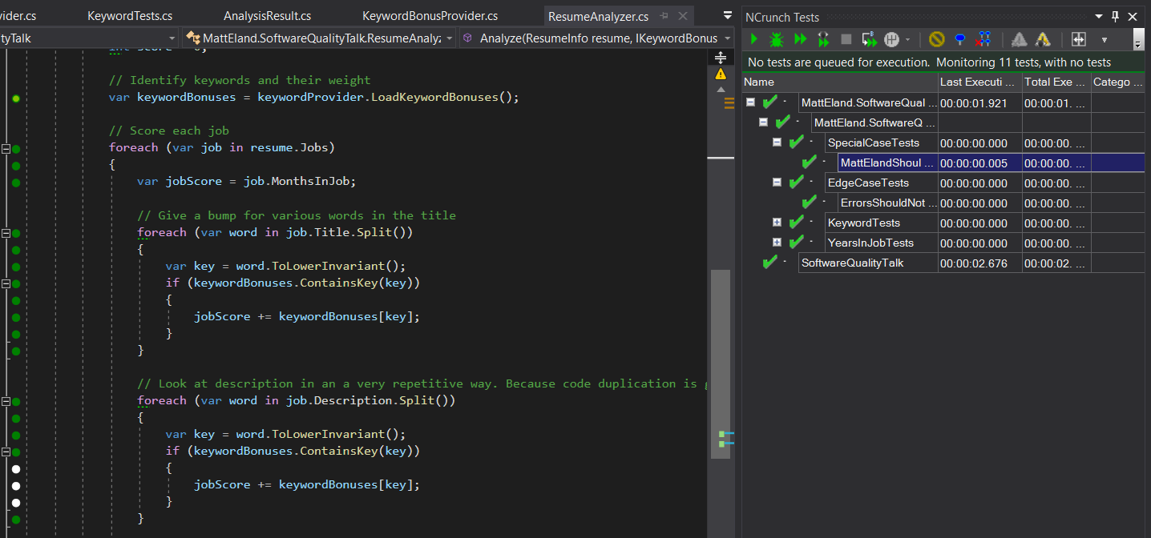
NCrunch
Passing test, but takes longer to execute than other lines
Covered by passing tests
These lines not covered by any tests
NCrunch: https://www.ncrunch.net/

Slide 54
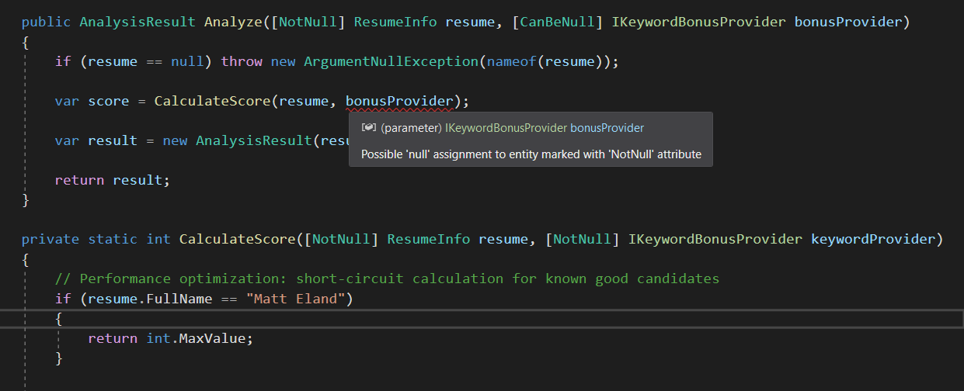
JetBrains Annotations
JetBrains Annotations Blog Post: https://tinyurl.com/jetbrains-annotations

Slide 55

Code Reviews
All Code is Peer Reviewed before testing occurs
Reviews can be informal to extremely formal
Best results if
Authors review their own code before submitting
Reviewers make multiple “themed” passes
Tracked via a system

Slide 56
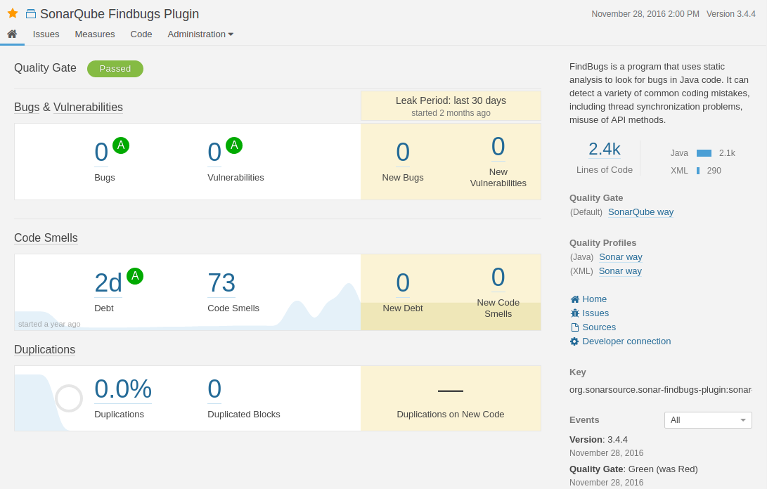
Code Analysis with SonarQube / SonarCloud
SonarQube: https://www.sonarqube.org/

Slide 57
CI/CD Pipeline Integration
Restore Dependencies
Build
Run Tests
Run Code Analysis
Publish Results
Track metrics over time
Integrate results into code review process
Should be repeatable
Notify on failure
TeamCity: https://www.jetbrains.com/teamcity/

Slide 58
Test Plans
Write Test Plans before coding
Write unit tests around test plans
Expand as needed after development work is done
Include Test Plans in Code Review
When handing a feature off to QA…
Provide the test plan you followed as a rough draft
Provide the list of unit tests added
Helps find edge cases
Helps others understand the change more

Slide 59
Functional Programming
Immutability / Pure Functions
Readonly Properties
Immutable Collections
Make Invalid State Impossible
F# Discriminated Unions
OneOf Library https://github.com/mcintyre321/OneOf
Functional Programming in C#
Language-Ext Library https://github.com/louthy/language-ext
Functional Programming in F#
Can call C#
Can be called by C#

Slide 60
Conclusion
Build a Safety Net
Improve Testability
Improve your Tests
Refactor the Code
Expand Your Tests
Snapper
AutoFac
Shouldly
Scientist .NET
FeatureToggle
SpecFlow
AutoFixture
Bogus
Moq
Data-Driven Tests
Selenium
Fiddler
In Memory EF
Postman
Slides and code available at: https://GitHub.com/IntegerMan/SoftwareQualityTalk/

Slide 61
Questions? Other Quality Recipes?
@IntegerMan
https://www.Linkedin.com/in/MattEland/
Slides and code available at: https://GitHub.com/IntegerMan/SoftwareQualityTalk/
Notes:
If you enjoyed this talk, please give me a mention on Twitter. I’m considering applying for CodeMash and every bit helps with selection.

